Slide 1
MBA(Master in Business Administration)
Business education is beyond theories – It’s about building leaders. The MBA program of SVSU aims at the comprehensive development of students by teaching business concepts, exposing students to resolve real life case studies, training them to be industry ready through regular industry visits.
The program builds the entrepreneurial skills of the students and provides students with a complete practical knowledge in multiple disciplines that include Marketing, Finance, Human Resource and more.
Impact on Career
The MBA programs are designed to boost the careers of students and by developing them into budding professionals, who lead and outperform in the dynamic corporate world, by adapting to the corporate culture, developing creative solutions, and creating value for organizations.
The SVSU’S MBA students are successful working in multiple sectors (Banking, HR, FMCG, IT, Education etc.)
UNIVERSITY
MBA course is under SWAMI VIVEKANANADA SUBHARTI UNIVESRSITY approved by UGC & DEB

Slide 2
SPECIALIZATION
DUAL SPECIALIZATION
INFORMATION TECHNOLOGY/ HUMAN RESOURCE MANAGEMENT/MARKETING MANAGEMENT/PRODUCTION & OPERATION MANAGEMENT / FINANCIAL MANAGEMENT
SINGLE SPECIALIZATION
HOTEL AND TOURISM MANAGEMENT/TELECOM MANAGEMENT/FASHION MANAGEMENT/PHARMCEUTICAL MARKETING/HOSPITAL ADMINISTRATION

Slide 3
DURATION
2 YEARS COURSE
ELIGIBILITY
GRADUATION OR EQUIVALENT
EXAM TYPE
YEARLY

Slide 4
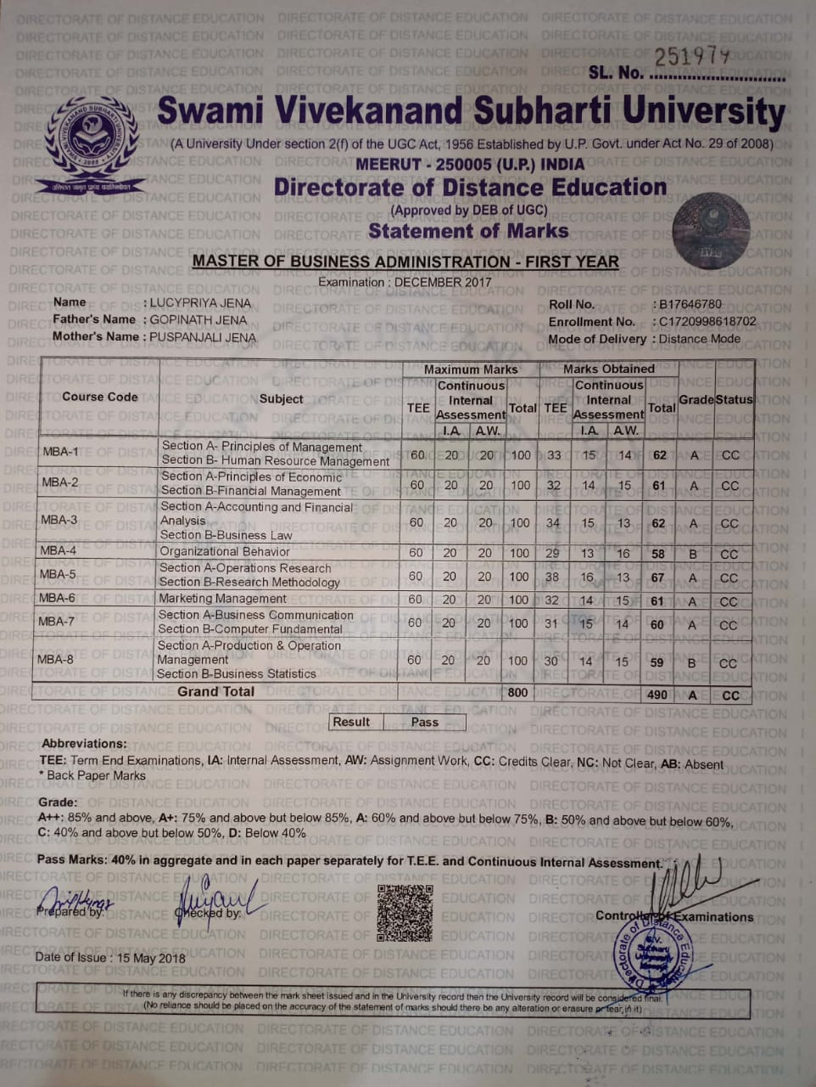
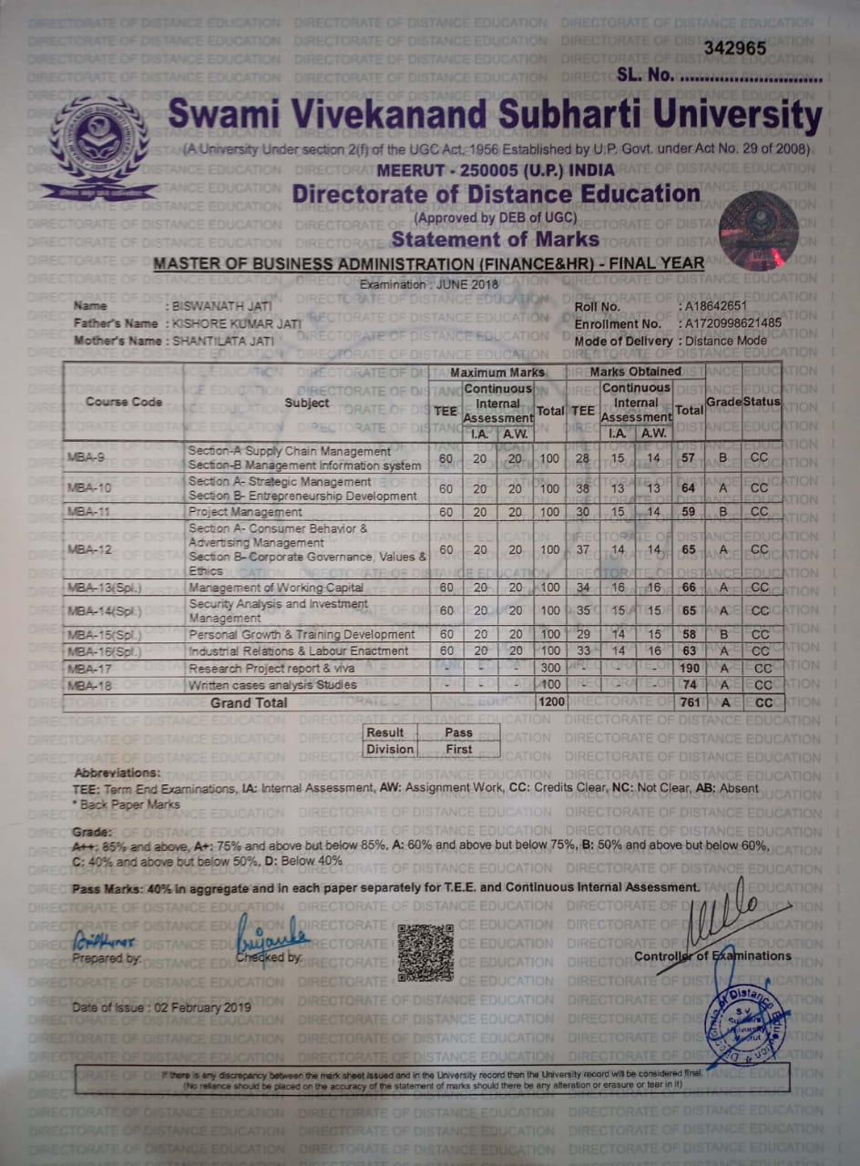
SAMPLE MARKSHEETS

Slide 5
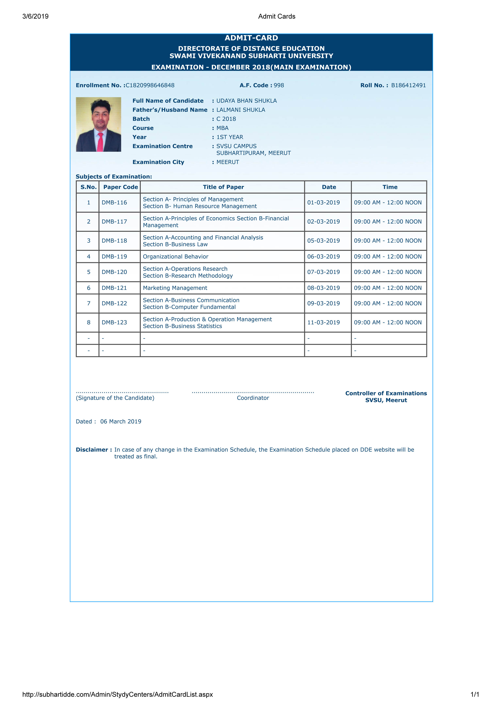
SAMPLE HALL TICKET OR ADMIT CARD

